Slide 1


Raccoons : DSL for CSV Data Processing
Team members:-
Mane Pooja Vinod:- CS22BTECH11035 (Project Manager)
Deva Suvedh:- CS22BTECH11016 (System Architect)
Medikonda Sreekar:- CS22BTECH11037 (System Architect)
Bolla Nehasree:- CS22BTECH11012 (Language Guru)
C Sree Vyshnavi:- CS24RESCH11010 (Language Guru)
Surbhi:- CS22BTECH11057 (System Integrator)
Simhadri Nayak Ramavath:-CS22BTECH11049 (Tester)

Slide 2

LEXICAL ANALYZER
The lexical analyzer scans the input .rc files and categorizes sequences of characters into tokens based on predefined patterns. Here's a breakdown of its key components:
1. Tokens:-
There are several tokens like keywords, operators, punctuation and special types of tokens.
Keywords:- for, while, if, else, int, float, string, bool, true, false, input, output, print,continue,break.
Operators:- +=, -=, *=, /=, %=, relational operators like <=, >=, ==, !=, + , - , * , \ , % , = , < , > , & , ^ , | and logical operators like &&, || , ++ , –- , >> , << .
Punctuation: ; , , , : , ( , ) , [ , ] , { , } , . . . ,”,’ .
Special Types: EXPONENTIAL , PERCENTAGE , INTEGER , FLOAT , STRING , CSVFILE .
2. Regular Expressions for Token Matching:-
The %% block contains regular expressions that match various components of the input source code and map them to specific token types. For example:
"for":- Matches the keyword "for" and returns the token FOR.
[0-9]+(\.[0-9]+)?% :- Matches percentage numbers and returns the PERCENTAGE token.
"\"([^\"\\]|\\.)*\"" :- Matches string literals enclosed in double quotes and returns the STRING token.
[A-Za-z_]+\.csv :- Matches filenames with the .csv extension and returns the CSVFILE token.

Slide 3
3. File I/O for Output:-
The lexer reads input from a file specified by the user and writes the tokenized output to an output file named output.txt.
It uses yyin for reading from the input file and writes the lexed tokens to outfile.
4. Multi-line and Single-line Comment Handling:-
Single-line comments: Lines starting with // are ignored by the lexer.
Multi-line comments: Handled by matching the start (/*) and end (*/) sequences and skipping everything in between.
5. Exponential Numbers, Identifiers, and Dust:-
The lexer is designed to recognize exponential numbers by the pattern [0-9]+(\.[0-9]+)?([eE][+-]?[0-9]+).
Identifiers follow the pattern [A-Za-z][A-Za-z0-9_]*.
The token DUST is returned for any unrecognized characters that don't fit other patterns.
6. Count( ) Function:-
This function counts the columns and keeps track of the current position in the input file, making sure to handle new lines and other characters correctly.
7. End-of-File Handling:-
The yywrap() function ensures that the lexer returns 1 when it reaches to the end of the input, indicating that tokenization is complete.
8.Main Function:-
The main() function reads the input file name, opens the input and output files, and continuously calls yylex() to process tokens until the end of the input is reached.

Slide 4
SAMPLE I/O OF LEXICAL ANALYZER
INPUT OF sample1.rc:-
//reads csv file as input
input weather_data.csv;
// Converts CSV file into data frame
df = read('weather_data.csv');
// Fills missing values with the median
df_filled = df.miss_value(fill,df.median());
// Calculate aggregate statistics
mean_temp = df_filled['Temperature'].mean();
max_wind_speed = df_filled['WindSpeed'].max();
sum_precipitation = df_filled['Precipitation'].sum();
// Print results
print(“Mean Temperature:”+mean_temp);
print("Max Wind Speed:”+max_wind_speed");
print("Total Precipitation:” + sum_precipitation);
df_filled.head();

Slide 5
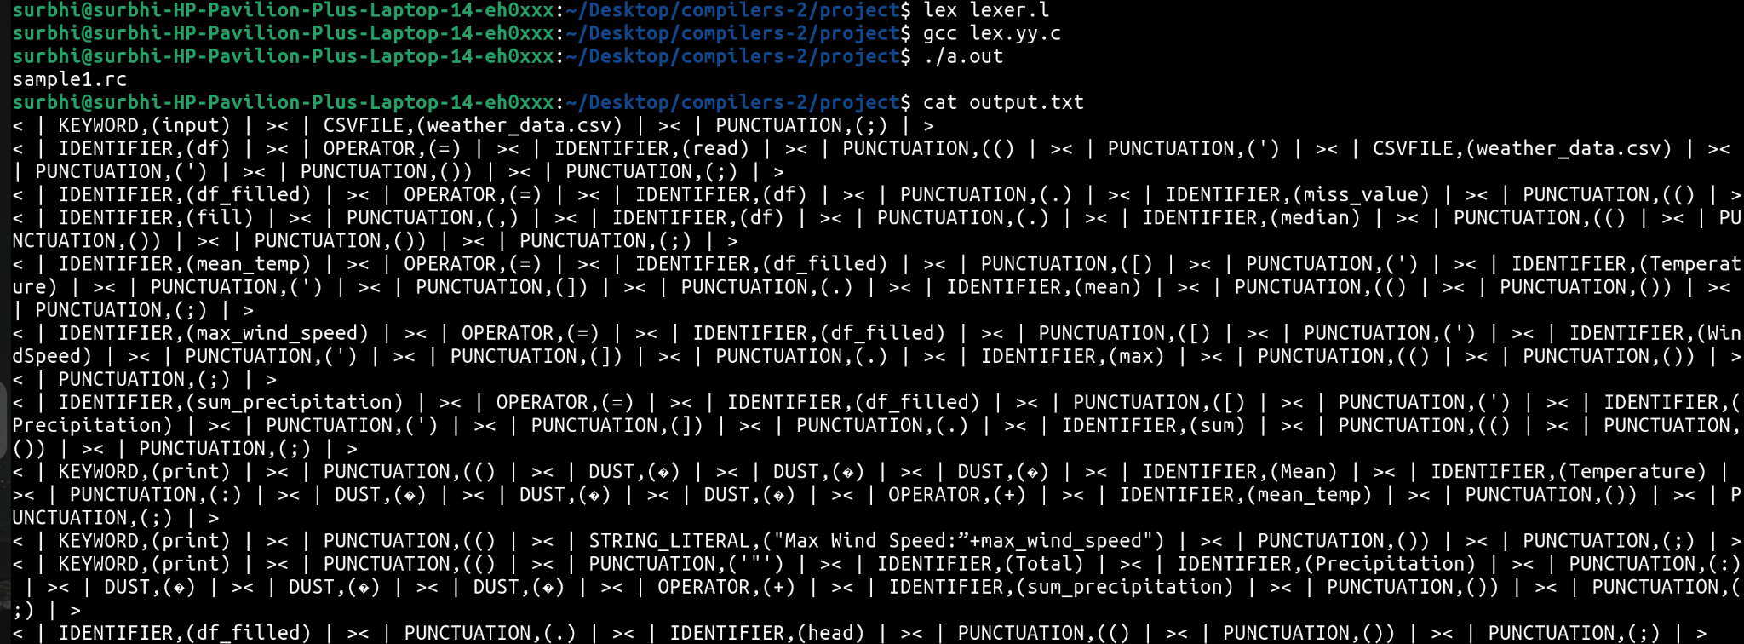
OUTPUT OF SAMPLE1.RC:-

Slide 6
INPUT FOR SAMPLE2.RC:-
//reads csv file as input
input weather_data.csv;
// Converts CSV file into data frame
df = read('weather_data.csv');
// Fills missing values with the median
df_filled = df.miss_value(fill,method=ffill);
// Group by Humidity and calculate the mean temperature
grouped = df.groupby('Humidity').agg({'Temperature': 'mean'});
// Reset index to make 'Humidity' a column again
grouped.reset_index();
//creating an output csv file
grouped.to_csv('Output.csv', index=False)
// Creating output csv of the grouped and aggregated data
output Output.csv

Slide 7
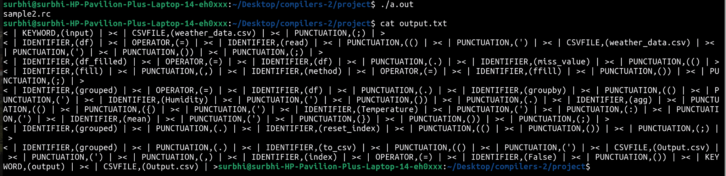
OUTPUT FOR SAMPLE 2.RC:-

Slide 8
INPUT FOR SAMPLE-3.RC:-
//reads csv file as input
input weather_data1.csv;
// Converts CSV file into data frame
df=df_filled
//obtained from EXAMPLE CODE 1
df2 =read('weather_data1.csv')
// Merge the two datasets on 'Date'
merged_df = pd.merge(df, df2, on='Date', how='outer',suffixes=('_1', '_2')));
// Interpolate missing values
interpolated_df = merged_df.interpolate(inplace=’False’);
// Print the first few rows of the merged and interpolated data
interpolated_df.head();

Slide 9
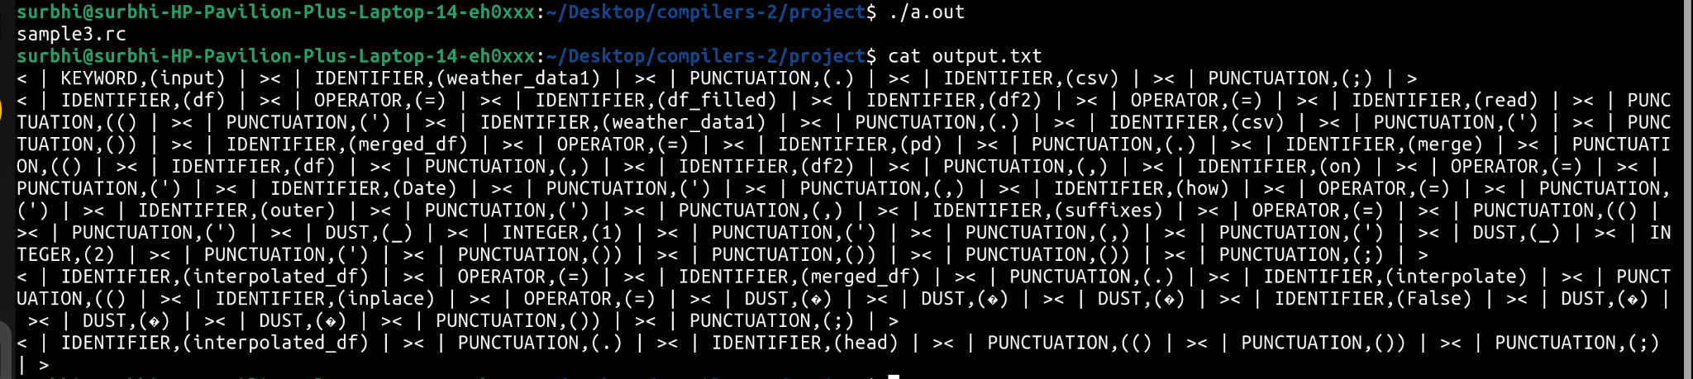
OUTPUT FOR SAMPLE-3.RC:-

Slide 10
PARSER ANALYZER
Parser takes input code is analyzed according to the grammar rules defined using Yacc.The goal of this phase is to check the syntactic structure of the input. Here's a breakdown of its key components:
Operator Precedence and Associativity:
Operators like +, -, *, /, and % have their precedence defined with %left, and %right for right-associative operators.
%nonassoc is used to define non-associative operators like <, >, and a special precedence rule LOWER_THAN_ELSE to handle if-else ambiguity.
Token Definitions:
Tokens like FOR, WHILE, IF, READCSVFUNC, and various operators (ADD_ASSIGN_OPERATOR, EQ_OPERATOR, etc.) are defined to represent keywords, operators, and function calls in the DSL.
SINGLE_QUOTED_STRING, INTEGER, and IDENTIFIER capture the string literals, integers, and variable names.

Slide 11
Grammar Rules:
translation_unit: The start symbol, representing the entire program. It's composed of one or more declarations.
declaration: Handles type declarations, assignments, function definitions, and input operations.
function_call_statement: Describes function calls like READCSVFUNC(), HEADFUNC(), and others used for CSV manipulation (grouping, merging, etc.).
assignment_statement: Defines how to assign results of function calls to identifiers.
control structures: Implements if-else, while, and for loops, allowing control flow in the DSL.
Parameter and Expression Handling:
parameter_list defines a list of parameters used in functions, while the expression_list handles expressions separated by commas.
The expression rule covers various arithmetic expressions and constants.
CSV Functionality: Functions like READCSVFUNC, HEADFUNC, TOCSVFUNC, and others are tokens for specific operations on CSV files.
function_call_statement details how these functions are invoked with their respective parameters or actions (like MISSVALUEFUNC handling missing values with fill_action).
Error Handling and Cleanup:
yyerror() reports syntax errors during parsing.
yywrap() ensures smooth termination when parsing ends.

